Slide 1
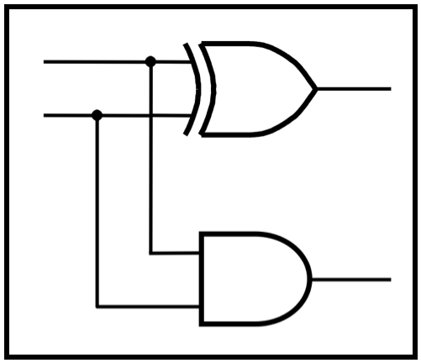
CprE 281:
Digital Logic
Instructor: Alexander Stoytchev
http://www.ece.iastate.edu/~alexs/classes/

Slide 2
Addition of Unsigned Numbers
CprE 281: Digital Logic
Iowa State University, Ames, IA
Copyright © Alexander Stoytchev

Slide 3
Administrative Stuff
HW5 is out
It is due on Monday Oct 3 @ 4pm.
Please write clearly on the first page (in BLOCK CAPITAL letters) the following three things:
  Your First and Last Name
  Your Student ID Number
  Your Lab Section Letter
Also, please
  Staple your pages

Slide 4
Administrative Stuff
Labs next week
Mini-Project
This is worth 3% of your grade (x2 labs)
http://www.ece.iastate.edu/~alexs/classes/2016_Fall_281/labs/Project-Mini/

Slide 5

Number Systems

Slide 6
Number Systems
n-th digit
(most significant)
0-th digit
(least significant)

Slide 7
Number Systems
base
power
n-th digit
(most significant)
0-th digit
(least significant)

Slide 8

The Decimal System

Slide 9



The Decimal System

Slide 10
Another Way to Look at This
5
2
4

Slide 11
Another Way to Look at This
10²
10¹
10⁰
5
2
4

Slide 12
Another Way to Look at This
10²
10¹
10⁰
labels
boxes
5
2
4
Each box can contain only one digit and has only one label. From right
to left, the labels are increasing powers of the base, starting from 0.

Slide 13

Base 7

Slide 14
Base 7
base
power

Slide 15
Base 7
base
power
most significant
digit
least significant
digit

Slide 16



Base 7

Slide 17
Another Way to Look at This
7²
7¹
7⁰
10²
10¹
10⁰
5
2
4
=
2
6
3

Slide 18
Binary Numbers (Base 2)

Slide 19
Binary Numbers (Base 2)
base
power
most significant bit
least significant bit

Slide 20
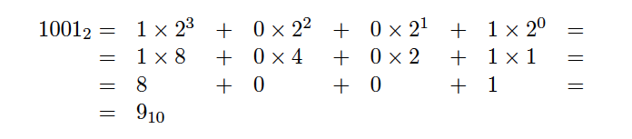
Binary Numbers (Base 2)

Slide 21
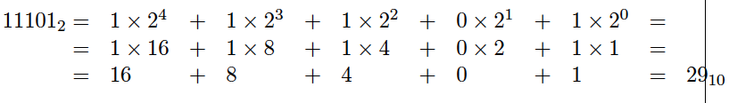
Another Example

Slide 22
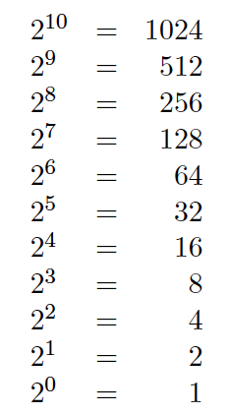
Powers of 2

Slide 23
What is the value of this binary number?
0 0 1 0 1 1 0 0
0 0 1 0 1 1 0 0
0*2⁷ + 0*2⁶ + 1*2⁵ + 0*2⁴ + 1*2³ + 1*2² + 0*2¹ + 0*2⁰
0*128 + 0*64 + 1*32 + 0*16 + 1*8 + 1*4 + 0*2 + 0*1
0*128 + 0*64 + 1*32 + 0*16 + 1*8 + 1*4 + 0*2 + 0*1
32+ 8 + 4 = 44 (in decimal)

Slide 24
Another Way to Look at This
2⁷
2⁶
2⁵
2⁴
2³
2²
2¹
2⁰
0
0
1
0
1
1
0
0

Slide 25
Binary numbers
Unsigned numbers
all bits represent the magnitude of a positive integer
Signed numbers
left-most bit represents the sign of a number

Slide 26
Table 3.1. Numbers in different systems.

Slide 27
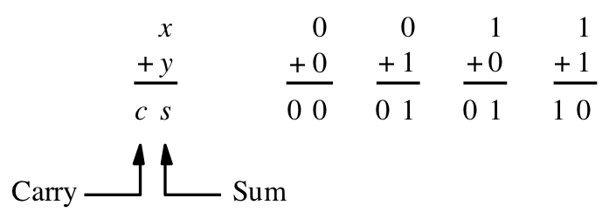
Adding two bits
(there are four possible cases)
[ Figure 3.1a from the textbook ]

Slide 28
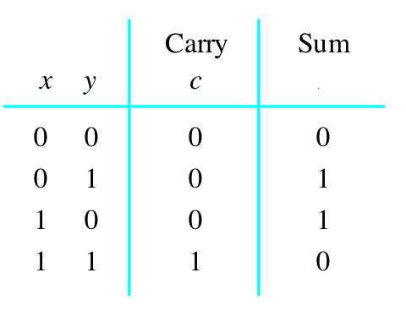
Adding two bits
(the truth table)
[ Figure 3.1b from the textbook ]

Slide 29
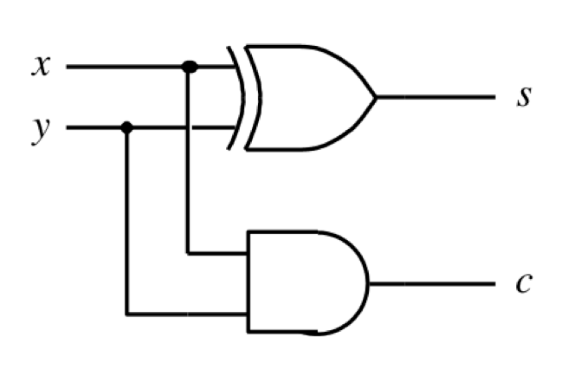
Adding two bits
(the logic circuit)
[ Figure 3.1c from the textbook ]

Slide 30
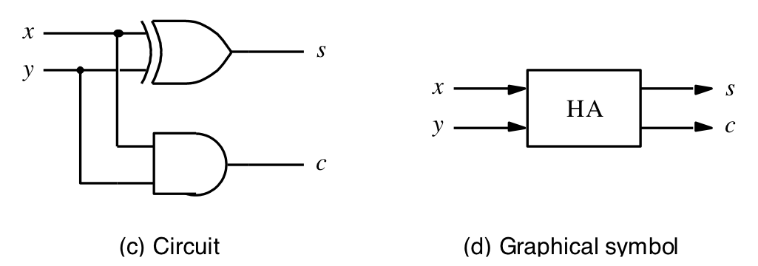
The Half-Adder
[ Figure 3.1c-d from the textbook ]

Slide 31
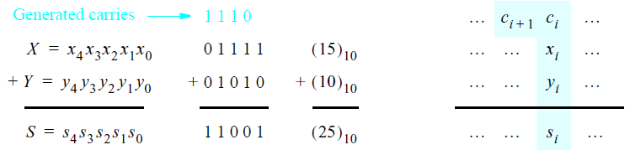
Addition of multibit numbers
Bit position i
[ Figure 3.2 from the textbook ]

Slide 32
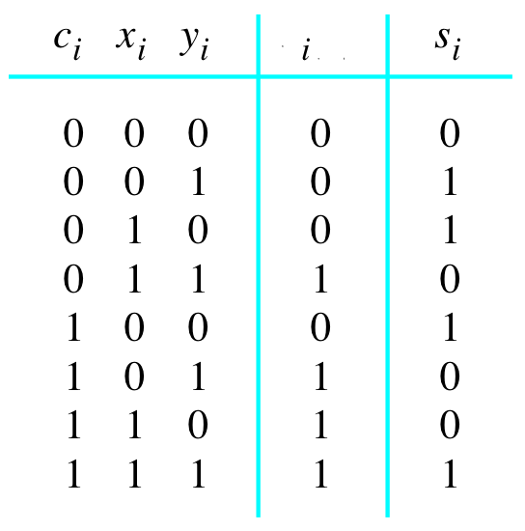

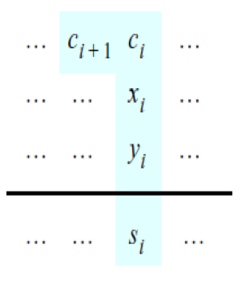
Problem Statement and Truth Table
[ Figure 3.2b from the textbook ]
[ Figure 3.3a from the textbook ]

Slide 33
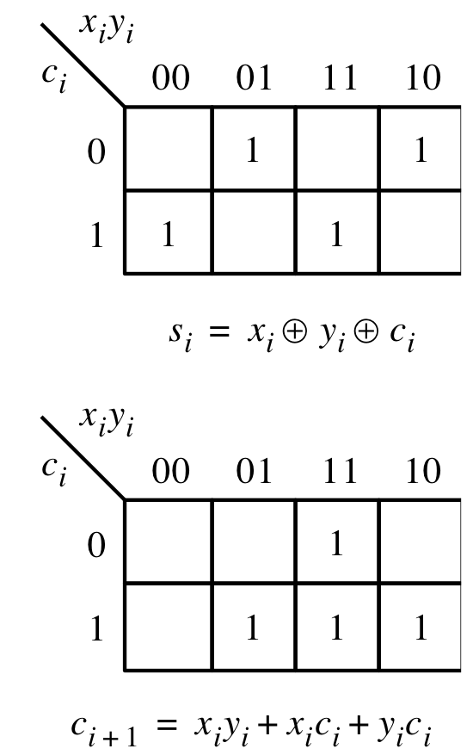
Let’s fill-in the two K-maps
[ Figure 3.3a-b from the textbook ]

Slide 34
Let’s fill-in the two K-maps
[ Figure 3.3a-b from the textbook ]

Slide 35
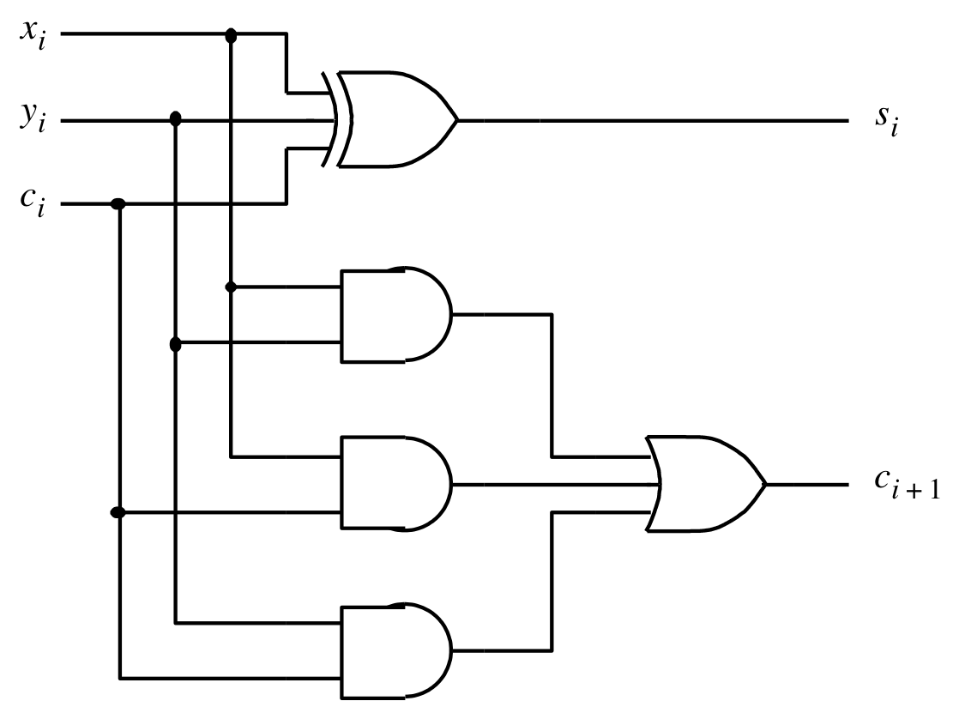


The circuit for the two expressions
[ Figure 3.3c from the textbook ]

Slide 36
This is called the Full-Adder
[ Figure 3.3c from the textbook ]

Slide 37
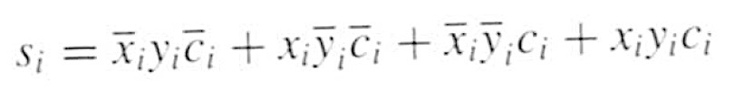
XOR Magic

Slide 38

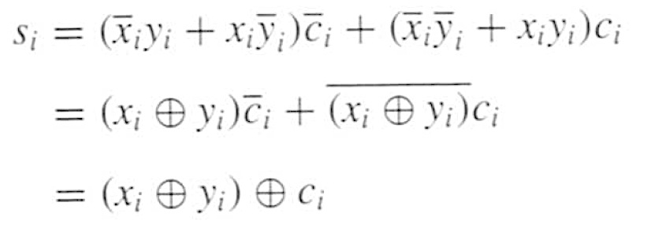
XOR Magic

Slide 39
XOR Magic
Can you prove this?

Slide 40

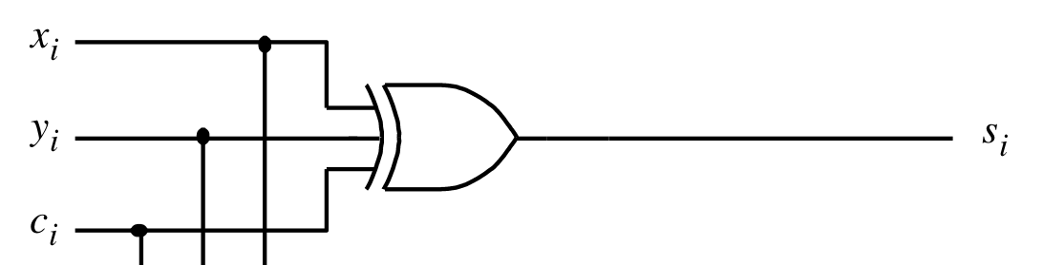
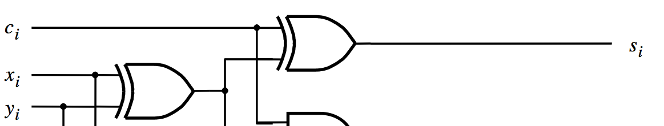
XOR Magic
(s_{i} can be implemented in two different ways)

Slide 41
A decomposed implementation
of the full-adder circuit
c
s
s
i
s
HA
c
i
x
i
HA
c
c
y
i
+
1
i
(a) Block diagram
c
i
s
i
x
i
y
i
c
i
+
1
(b) Detailed diagram
[ Figure 3.4 from the textbook ]

Slide 42
The Full-Adder Abstraction
c
s
s
i
HA
i
x
s
c
i
HA
c
y
c
i
+
1
i

Slide 43
The Full-Adder Abstraction
c
s
i
i
x
FA
i
c
y
i
+
1
i

Slide 44
We can place the arrows anywhere
x_{i}
y_{i}
c_{i+1}
FA
c_{i}
s_{i}

Slide 45
n-bit ripple-carry adder
x
y
x
y
x
y
n –
1
n
–
1
1
1
0
0
c
c
c
c
1
c
n
FA
n
”
1
2
FA
FA
0
s
s
s
n
–
1
1
0
MSB position
LSB position
[ Figure 3.5 from the textbook ]

Slide 46
n-bit ripple-carry adder abstraction
x
y
x
y
x
y
n –
1
n
–
1
1
1
0
0
c
c
c
c
1
c
n
FA
n
”
1
2
FA
FA
0
s
s
s
n
–
1
1
0
MSB position
LSB position

Slide 47
n-bit ripple-carry adder abstraction
x
y
x
y
x
y
n –
1
n
–
1
1
1
0
0
c
c
n
0
s
s
s
n
–
1
1
0

Slide 48
The x and y lines are typically
grouped together for better visualization,
but the underlying logic remains the same
x
x
x
y
y
y
n –
1
1
0
n
–
1
1
0
c
c
n
0
s
s
s
n
–
1
1
0

Slide 49
Design Example:
Create a circuit that multiplies a number by 3

Slide 50
How to Get 3A from A?
3A = A + A + A
3A = (A+A) + A
3A = 2A +A

Slide 51
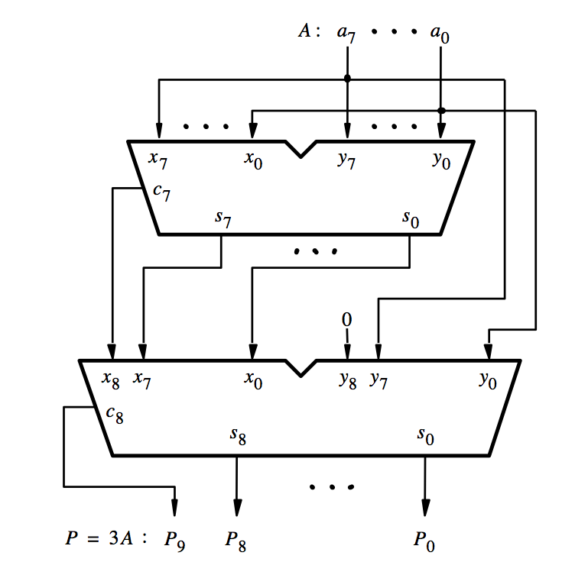
[ Figure 3.6a from the textbook ]

Slide 52
Decimal Multiplication by 10
What happens when we multiply a number by 10?
  4 x 10 = ?
542 x 10 = ?
1245 x 10 = ?

Slide 53
Decimal Multiplication by 10
What happens when we multiply a number by 10?
  4 x 10 = 40
542 x 10 = 5420
1245 x 10 = 12450

Slide 54
Decimal Multiplication by 10
What happens when we multiply a number by 10?
  4 x 10 = 40
542 x 10 = 5420
1245 x 10 = 12450
You simply add a zero as the rightmost number

Slide 55
Binary Multiplication by 2
What happens when we multiply a number by 2?
  011 times 2 = ?
101 times 2 = ?
110011 times 2 = ?

Slide 56
Binary Multiplication by 2
What happens when we multiply a number by 2?
  011 times 2 = 0110
101 times 2 = 1010
110011 times 2 = 1100110

Slide 57
Binary Multiplication by 2
What happens when we multiply a number by 2?
  011 times 2 = 0110
101 times 2 = 1010
110011 times 2 = 1100110
You simply add a zero as the rightmost number

Slide 58
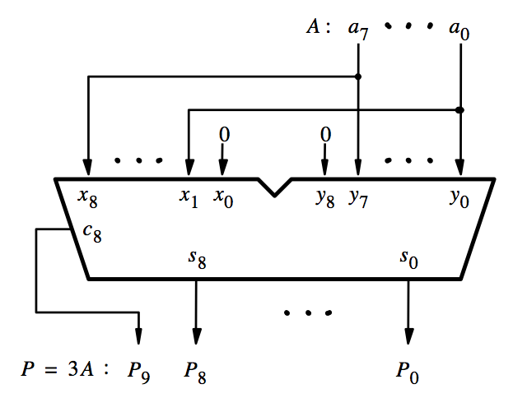
[ Figure 3.6b from the textbook ]

Slide 59
This is how we get 2A
[ Figure 3.6b from the textbook ]

Slide 60
2A
A
3A
[ Figure 3.6b from the textbook ]

Slide 61
Questions?

Slide 62
THE END

